Slide 1
PREDICTING CUSTOMER BUYING BEHAVIOUR
BY: PARVEJ ALAM M. ANSARI
DATE: 08-SEPTEMBER-2023

Slide 2
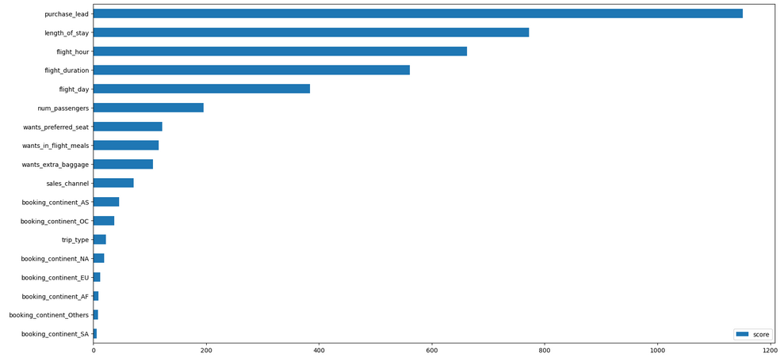
Feature Importance Horizontal Bar Chart

Slide 3
Analysis of Feature Importance Horizontal Bar Chart
Question:
Whether the Customer will Complete the air booking or Not? What factors are responsible for the same?
Observation:
From Feature Importance bar chart, the Customer buying behaviour depends upon following top five factors:
purchase_lead (number of days between travel date and booking date)
length_of_stay (number of days spent at destination)
flight_hour (hour of flight departure)
flight_duration (total duration of flight in hours)
flight_day (day of week of flight departure)

